Slide 1


Netherlands initiative
Notes:
TALK EDDY

Slide 2



HTTPS://WWW.LITTIL.ORG
Notes:
TALK EDDY
Anyone in the audience who don’t know what Devoxx4Kids is
Anyone in the audience who did hear already about project LITTIL

Slide 3
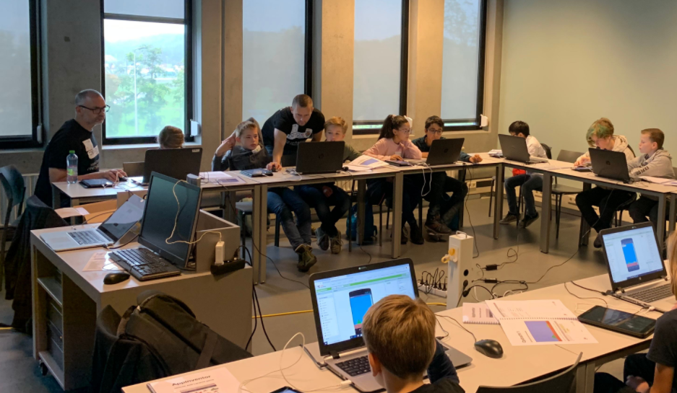
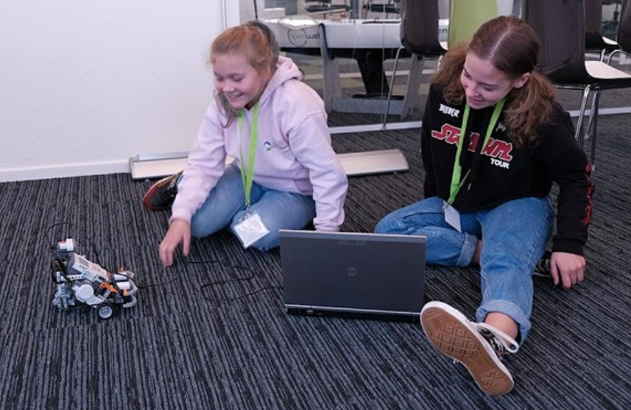

Founded in 2011 by Stephan Jansen – Devoxx Belgium
Goal : Let children (8 – 14) learn in a fun way how to program
25 Countries with a Devoxx4Kids Foundation
Founded in 2014
HTTPS://WWW.LITTIL.ORG
Notes:
TALK EDDY

Slide 4
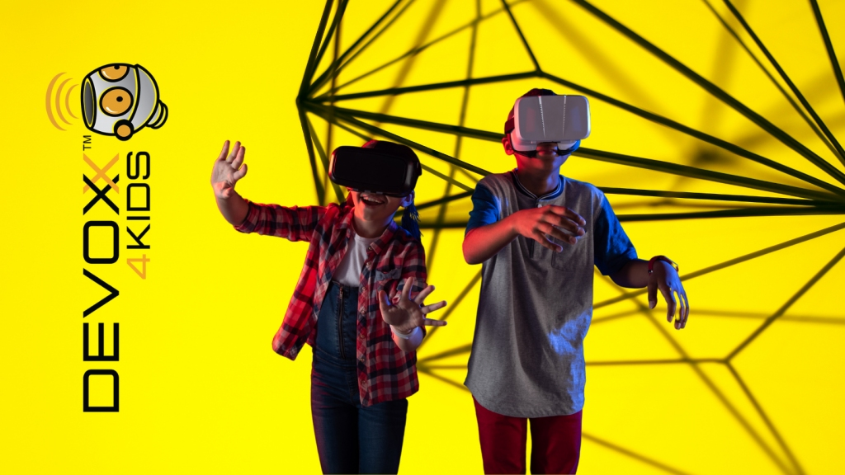
2014 – 2020 Devoxx4Kids days at several companies
2020 ????
HTTPS://WWW.LITTIL.ORG
Notes:
TALK EDDY
Explain Devoxx4Kids WOW

Slide 5
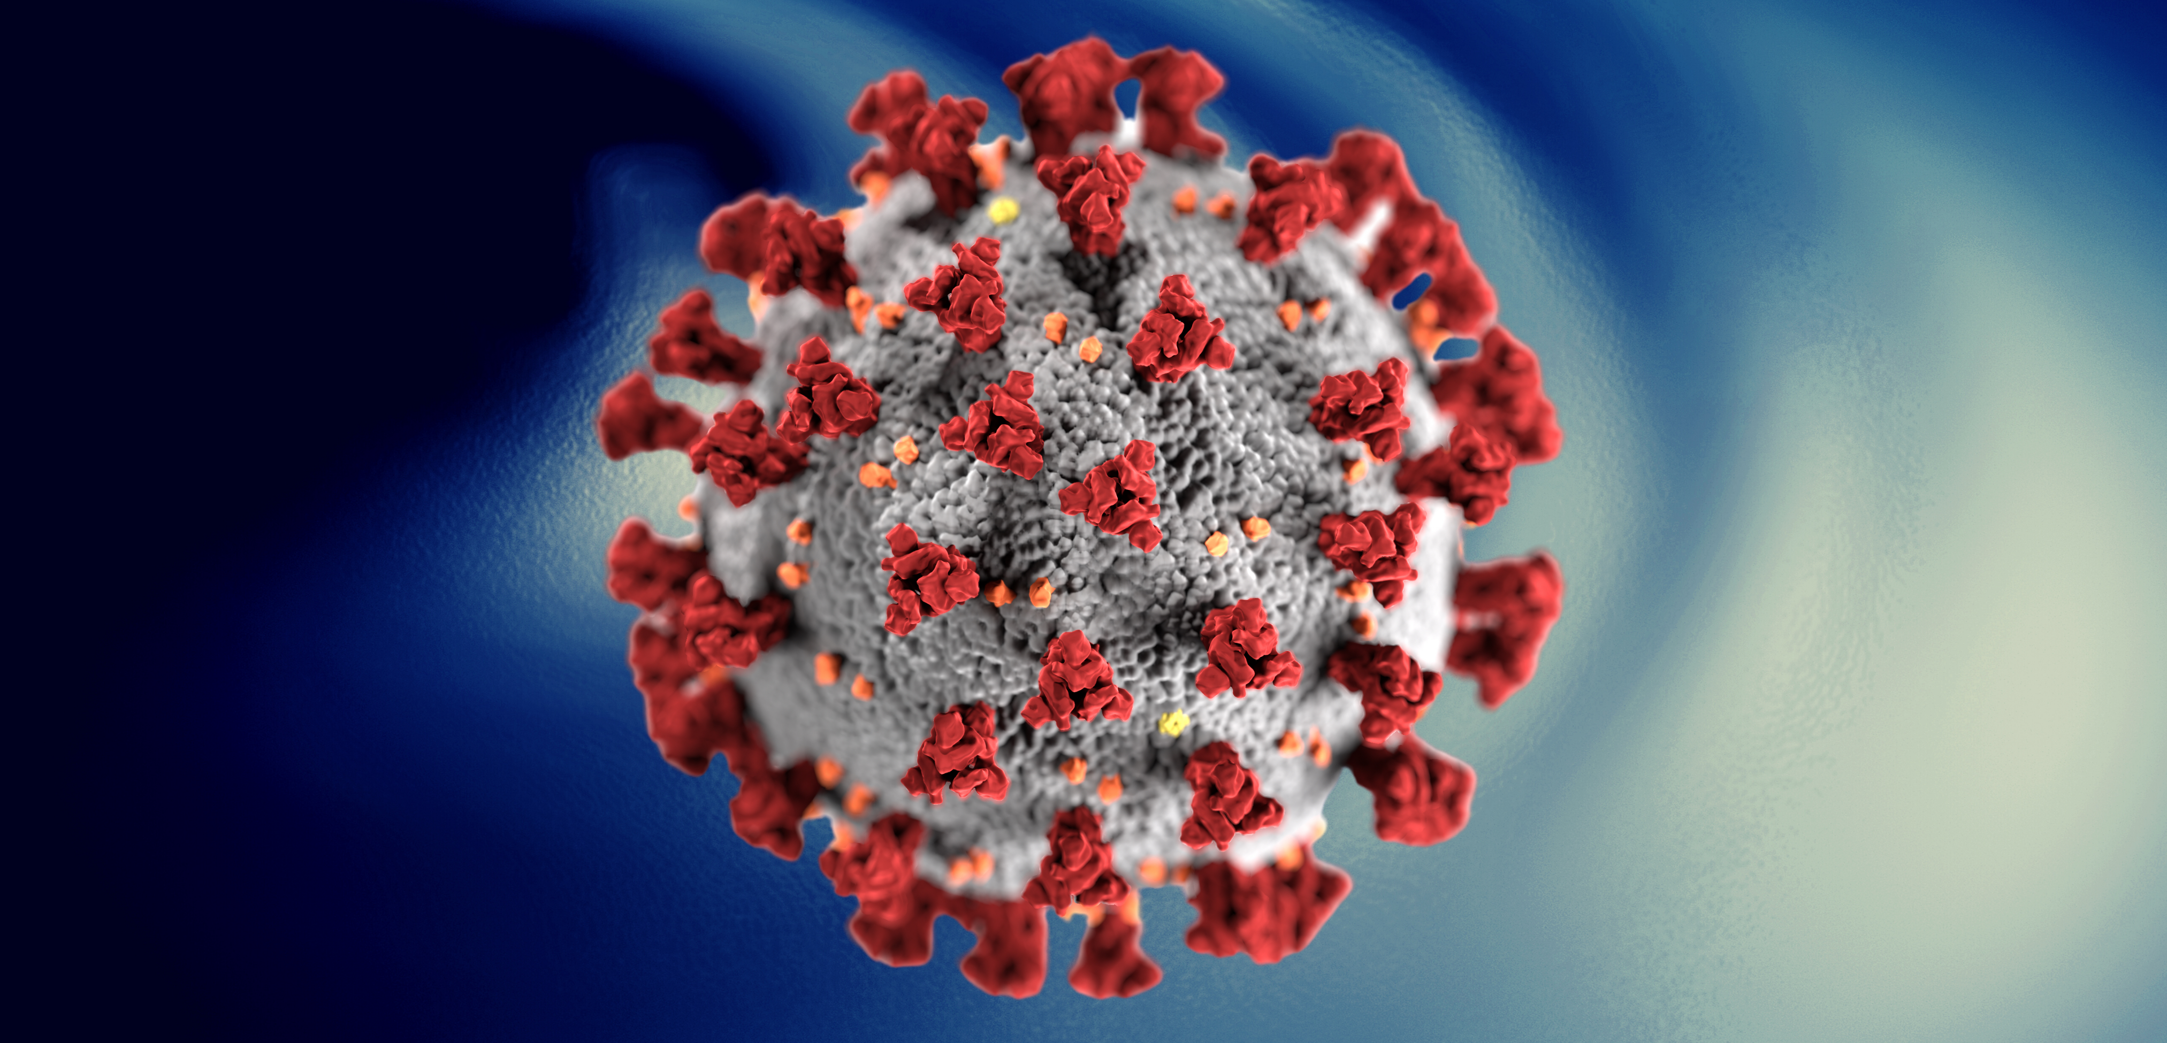
2014 – 2020 Devoxx4Kids days at several companies
HTTPS://WWW.LITTIL.ORG
Notes:
TALK EDDY

Slide 6
2014 – 2020 Devoxx4Kids days at several companies
≠
HTTPS://WWW.LITTIL.ORG
Notes:
TALK EDDY

Slide 7



Is there a school where I can be a guest IT teacher?
Where do we find a
guest IT teacher??
Is there a platform where I can store my lessons for children?
HTTPS://WWW.LITTIL.ORG
Notes:
TALK EDDY
Brainstorming
Birth of LITTIL
Who was brainstorming?

Slide 8

Welcome to
the World
Born October 2021
HTTPS://WWW.LITTIL.ORG
Notes:
TALK EDDY
Birth of LITTIL

Slide 9
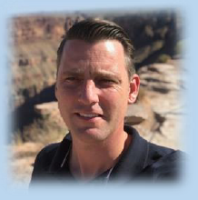
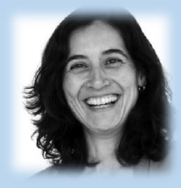
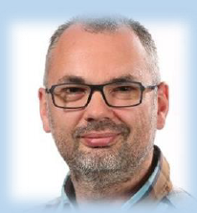
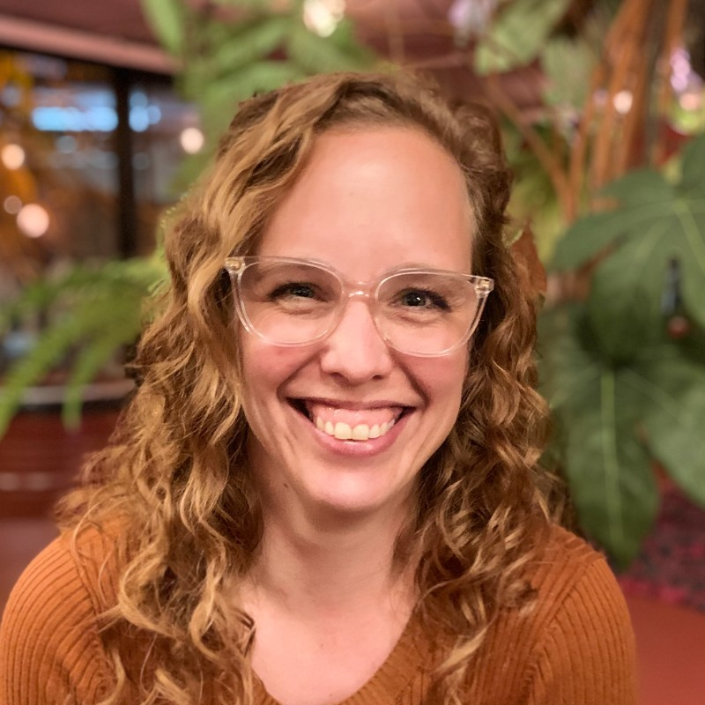
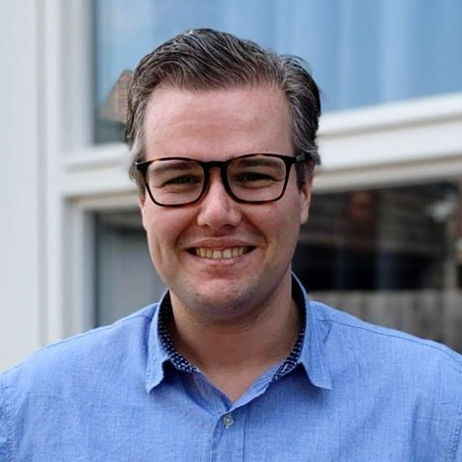
Devoxx4Kids Netherlands Board
Koen Aerts
President
Saskia Vermeer Ooms
Secretary
Eddy Vos
Treasurer
LITTIL Team
Eddy Vos
Product Owner Scrum Master
Anja van Hagen
Lead Front-End
Pepijn Schildkamp
Lead Back-End
HTTPS://WWW.LITTIL.ORG
Notes:
TALK EDDY

Slide 10
Eddy Vos
Java Software Developer
Developer Experience Team ABN AMRO
Organizer ABN AMRO DevCon, MeetUps, Tech Events
Wife and 2 Kids
Ede – The Netherlands
Devoxx4Kids Netherlands Board Member - Treasurer
Devoxx4Kids LITTIL Product Owner
HTTPS://WWW.LITTIL.ORG
Notes:
TALK EDDY

Slide 11

Pepijn Schildkamp
Solution Architect - CRV
Arnhem – The Netherlands
Co-Founder Arnhem JUG
Devoxx4Kids LITTIL Lead Back-End Development
HTTPS://WWW.LITTIL.ORG
Notes:
Talk Pepijn

Slide 12
What is LITTIL
Open Source
Meeting place for Schools & IT Engineers
Schools get help from IT Engineers as a Guest Teacher for free
Free use of all coding materials
HTTPS://WWW.LITTIL.ORG
Notes:
Talk Eddy

Slide 13
LITTIL Historie
OCT
2021
NOV
2021
JAN
2022
MAR
2022
APR
2022
MAY
2022
JUL
2022
OCT
2022
NOV
2022
JAN
2023
60 IT volunteers – Kick Off
3 Scrum Teams
Schools
Guest Teachers
Market Research
HTTPS://WWW.LITTIL.ORG
Notes:
Talk Eddy
Be honest, our idea is not unique
Also partnership -> we have a mission

Slide 14


LITTIL Historie
OCT
2021
NOV
2021
JAN
2022
MAR
2022
APR
2022
MAY
2022
JUL
2022
OCT
2022
NOV
2022
JAN
2023
HTTPS://WWW.LITTIL.ORG
Notes:
Talk Pepijn
Domain registration

Slide 15
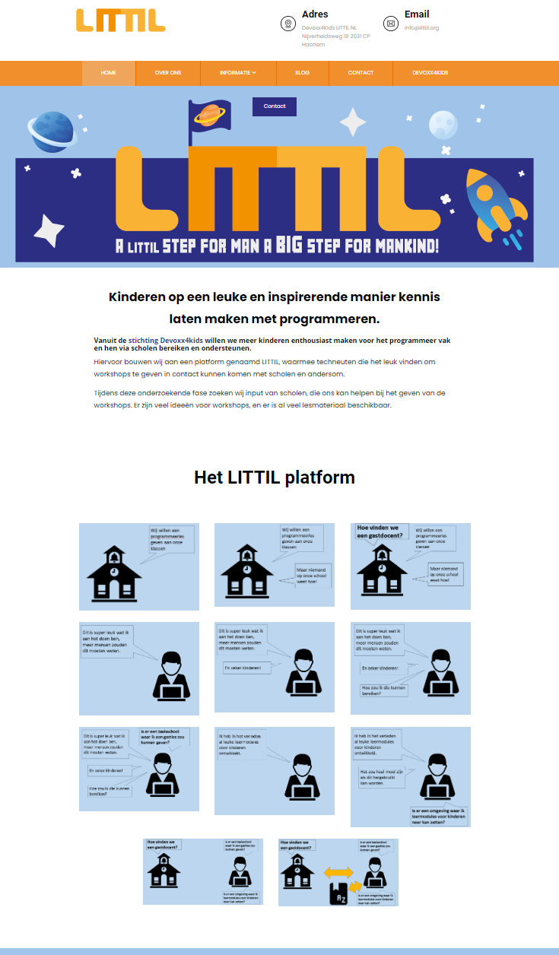
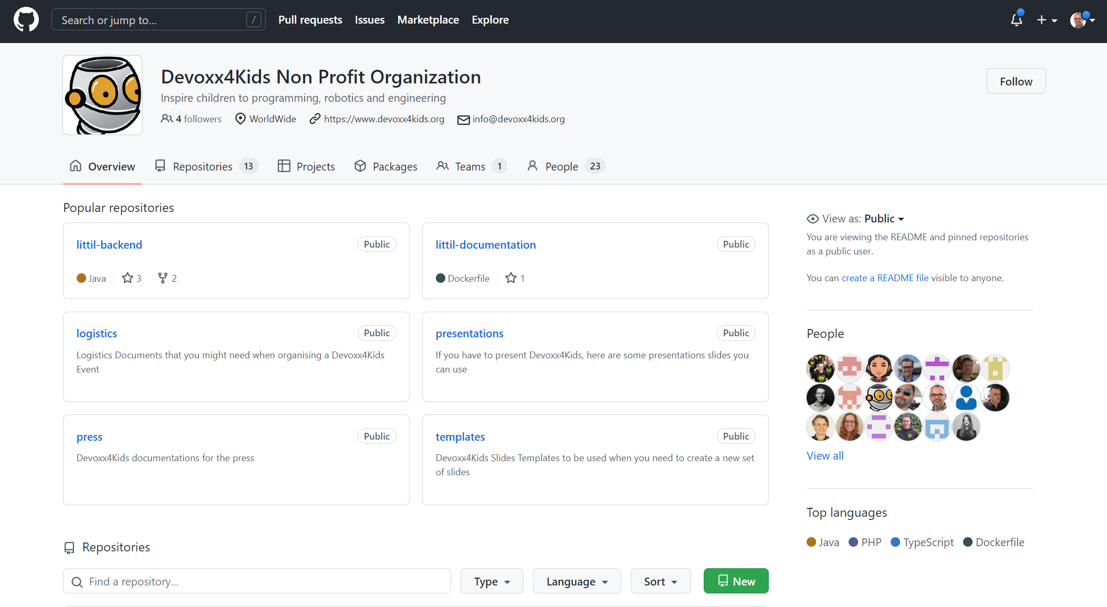
LITTIL Historie
OCT
2021
NOV
2021
JAN
2022
MAR
2022
APR
2022
MAY
2022
JUL
2022
OCT
2022
NOV
2022
JAN
2023
3 Scrum Teams
Front-End
Back-End
Architecture & Infra
Website & Repo LIVE
HTTPS://WWW.LITTIL.ORG
Notes:
Talk Pepijn

Slide 16


















LITTIL Historie
FUNDING!!
OCT
2021
NOV
2021
JAN
2022
MAR
2022
APR
2022
MAY
2022
JUL
2022
OCT
2022
NOV
2022
JAN
2023
HTTPS://WWW.LITTIL.ORG
Notes:
Talk Pepijn

Slide 17

LITTIL Historie
OCT
2021
NOV
2021
JAN
2022
MAR
2022
APR
2022
MAY
2022
JUL
2022
OCT
2022
NOV
2022
JAN
2023
10 IT Volunteers for coding platform
Interviews converted in User Stories
No working codebase
6 Months
HTTPS://WWW.LITTIL.ORG
Notes:
Talk Eddy
Difficult to make choices on your own to start up
Eager to do first time right

Slide 18
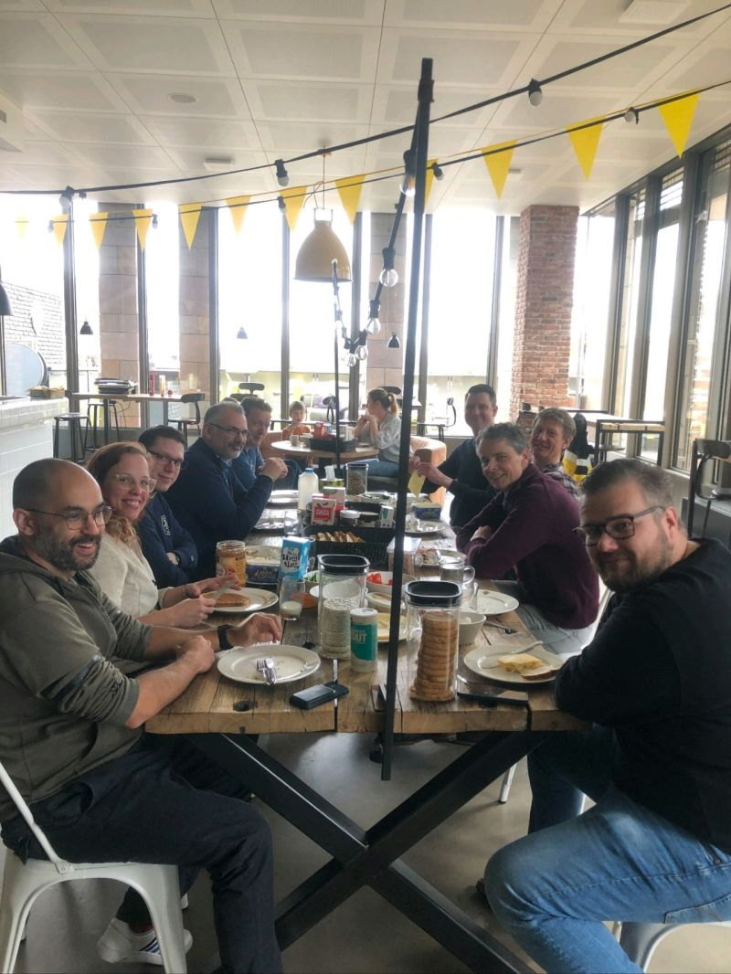

LITTIL Historie
OCT
2021
NOV
2021
JAN
2022
MAR
2022
APR
2022
MAY
2022
JUL
2022
OCT
2022
NOV
2022
JAN
2023
HTTPS://WWW.LITTIL.ORG
Notes:
Talk Eddy
BUSY MONTH!

Slide 19

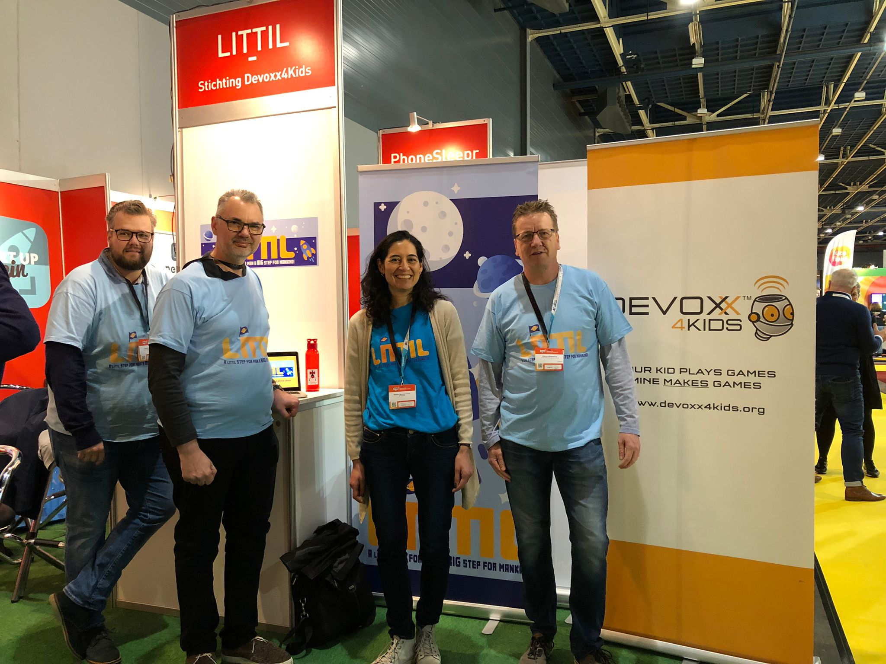
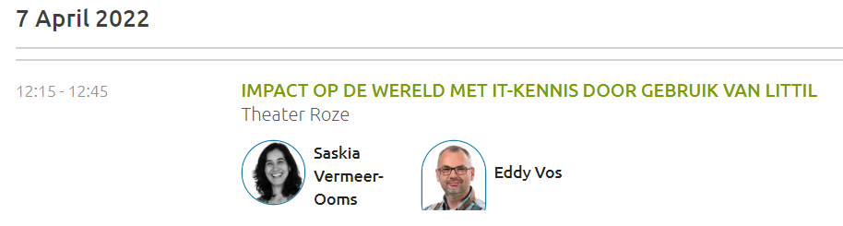
LITTIL Historie
OCT
2021
NOV
2021
JAN
2022
MAR
2022
APR
2022
MAY
2022
JUL
2022
OCT
2022
NOV
2022
JAN
2023
IPON (Innovation Platform Education Netherlands)
NEW INSIGHTS !!!
HTTPS://WWW.LITTIL.ORG
Notes:
Talk Eddy
2 Days event
6000 Visitors from Primary school till University
Each Day LITTIL on stage

Slide 20
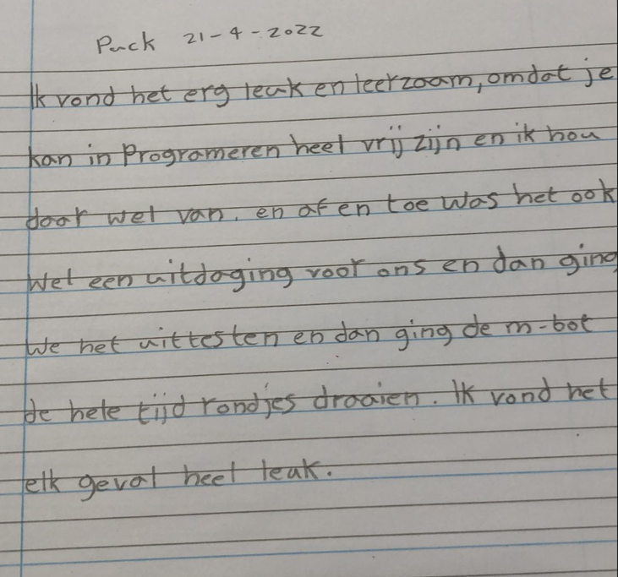
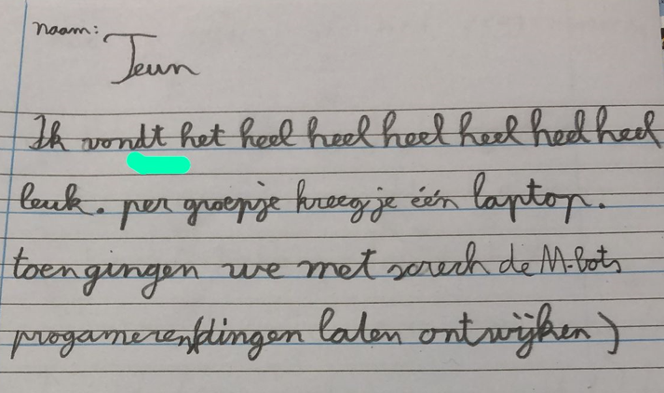
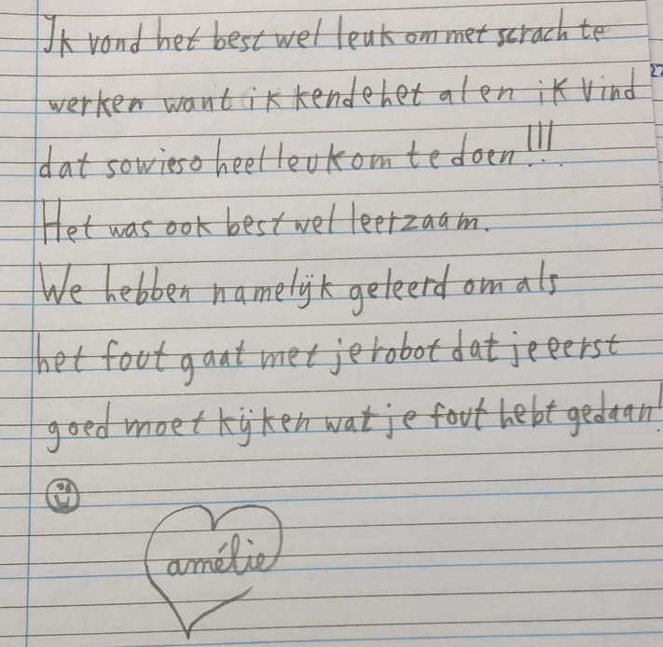
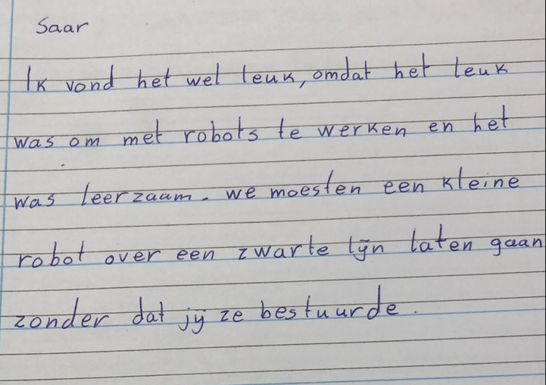
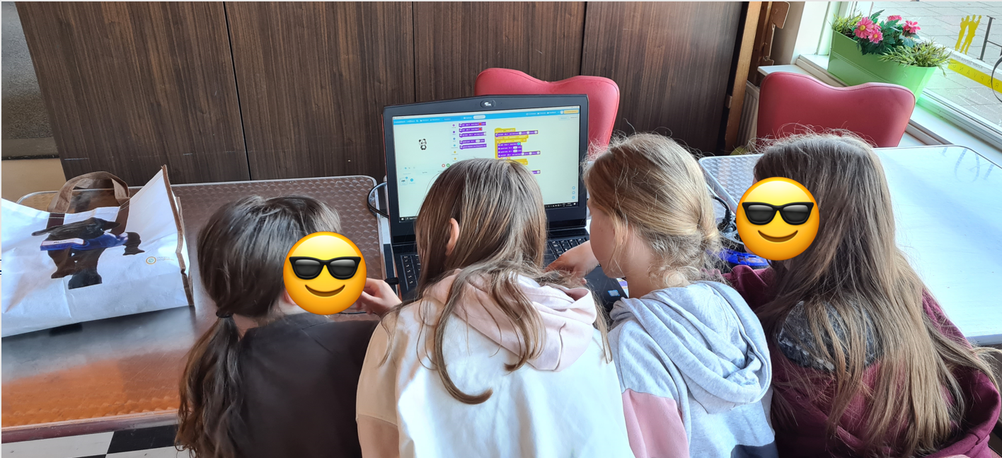
LITTIL Historie
OCT
2021
NOV
2021
JAN
2022
MAR
2022
APR
2022
MAY
2022
JUL
2022
OCT
2022
NOV
2022
JAN
2023
☺
First dry-run teaching at a primary school
HTTPS://WWW.LITTIL.ORG
Notes:
Talk Eddy
ITS WORKING!
Feedback -> Grammar correction

Slide 21
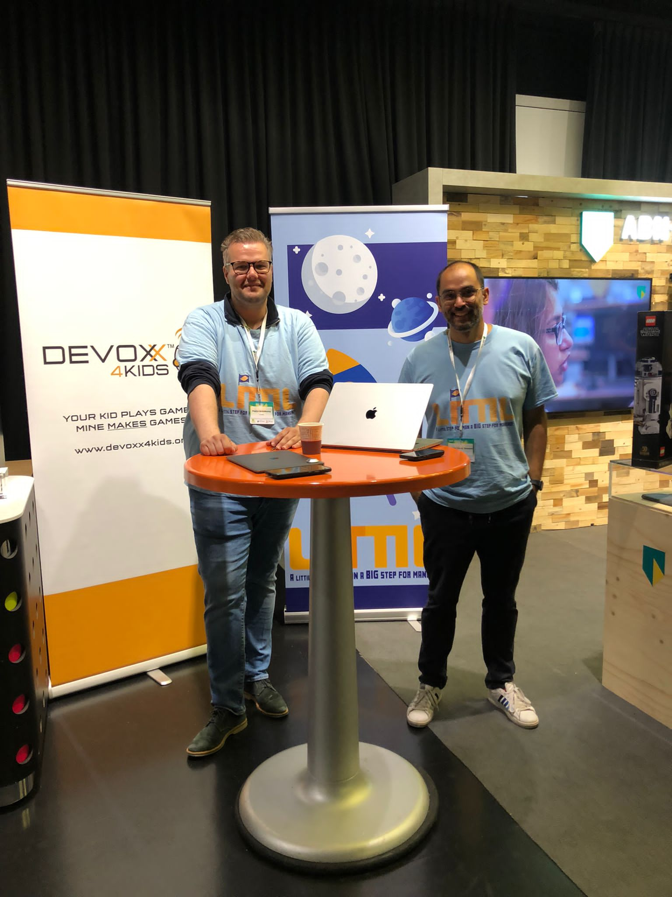


LITTIL Historie
OCT
2021
NOV
2021
JAN
2022
MAR
2022
APR
2022
MAY
2022
JUL
2022
OCT
2022
NOV
2022
JAN
2023
HTTPS://WWW.LITTIL.ORG
Notes:
Talk Pepijn
SIGNED UP!
INTEREST IN GUEST TEACHER

Slide 22
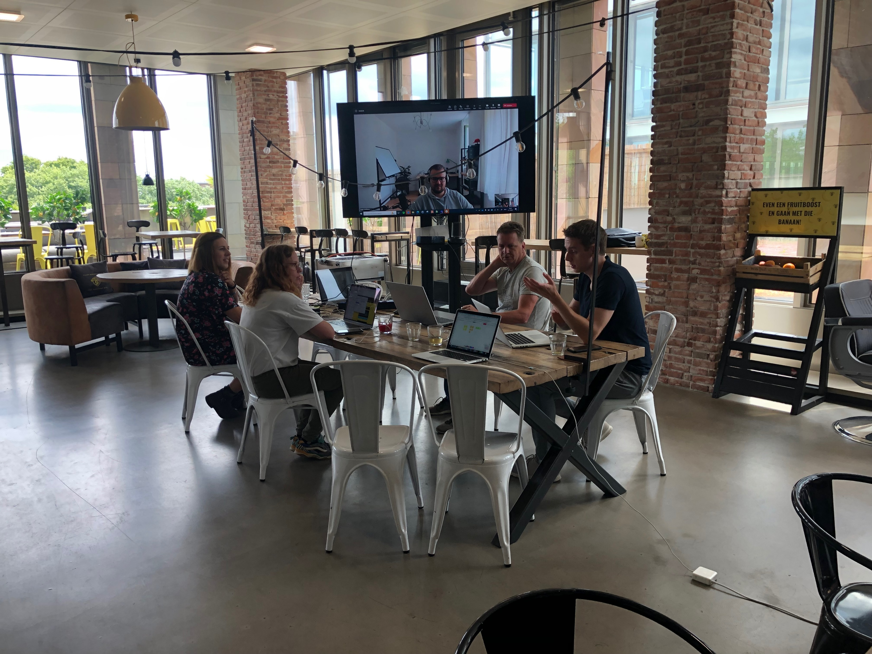
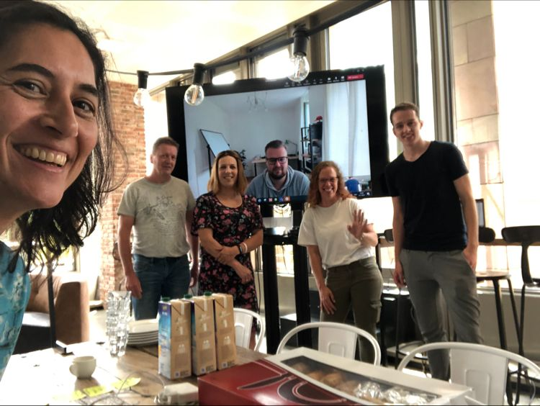
LITTIL Historie
OCT
2021
NOV
2021
JAN
2022
MAR
2022
APR
2022
MAY
2022
JUL
2022
OCT
2022
NOV
2022
JAN
2023
2nd
HTTPS://WWW.LITTIL.ORG
Notes:
Talk Pepijn

Slide 23
LITTIL Historie
FUNDING!!
OCT
2021
NOV
2021
JAN
2022
MAR
2022
APR
2022
MAY
2022
JUL
2022
OCT
2022
NOV
2022
JAN
2023
HTTPS://WWW.LITTIL.ORG
Notes:
Talk Eddy
Remember this one

Slide 24






LITTIL Historie
OCT
2021
NOV
2021
JAN
2022
MAR
2022
APR
2022
MAY
2022
JUL
2022
OCT
2022
NOV
2022
JAN
2023
HTTPS://WWW.LITTIL.ORG
Notes:
Talk Eddy
Springboot -> Quarkus
Little other changes -> less is more
DUTCH TAX OFFICE → CONFIRMED AS OFFICIAL CHARITY PROGRAM

Slide 25
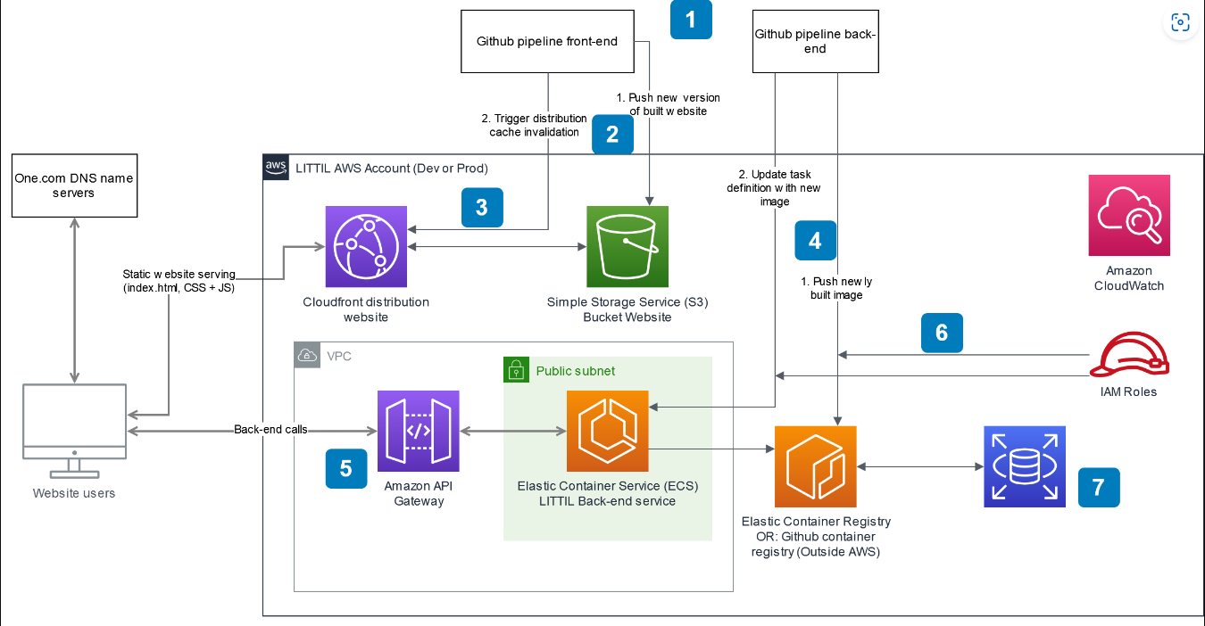
LITTIL Historie
OCT
2021
NOV
2021
JAN
2022
MAR
2022
APR
2022
MAY
2022
JUL
2022
OCT
2022
NOV
2022
JAN
2023
HTTPS://WWW.LITTIL.ORG
Notes:
Talk Pepijn
LATER IN DETAIL (PEPIJN)

Slide 26

LITTIL Historie
OCT
2021
NOV
2021
JAN
2022
MAR
2022
APR
2022
MAY
2022
JUL
2022
OCT
2022
NOV
2022
JAN
2023
HTTPS://WWW.LITTIL.ORG
Notes:
Talk Pepijn
→ SHOW LIVE AWS ENVIRONMENT

Slide 27
LITTIL Future
OCT
2021
NOV
2021
JAN
2022
MAR
2022
APR
2022
MAY
2022
JUL
2022
OCT
2022
NOV
2022
JAN
2023
AWS Production Environment [MVP1] – November 2022
MVP1 = Registration Guest Teacher
MVP1 = Registration School
MVP1 = Finding each other
HTTPS://WWW.LITTIL.ORG
Notes:
Talk Pepijn

Slide 28

LITTIL Future
OCT
2021
NOV
2021
JAN
2022
MAR
2022
APR
2022
MAY
2022
JUL
2022
OCT
2022
NOV
2022
JAN
2023
MVP 2 – January 2023
Messaging system
HTTPS://WWW.LITTIL.ORG
Notes:
Talk Pepijn

Slide 29

LITTIL Help needed
Front-End & Back-End
Coding material for kids
SCRATCH
CODE COMBAT
HEDY (https://www.hedycode.com/ )
Infra as code
HTTPS://WWW.LITTIL.ORG
Notes:
Talk Eddy
Only 1 AWS expert we need backups

Slide 30


What did we learn
Voluntary is not without obligation
Time is your enemy
HTTPS://WWW.LITTIL.ORG
Notes:
Talk Eddy

Slide 31

What did we learn
Voluntary is not without obligation
Time is your enemy
Initiating a hackathon creates speed
HTTPS://WWW.LITTIL.ORG
Notes:
Talk Eddy

Slide 32
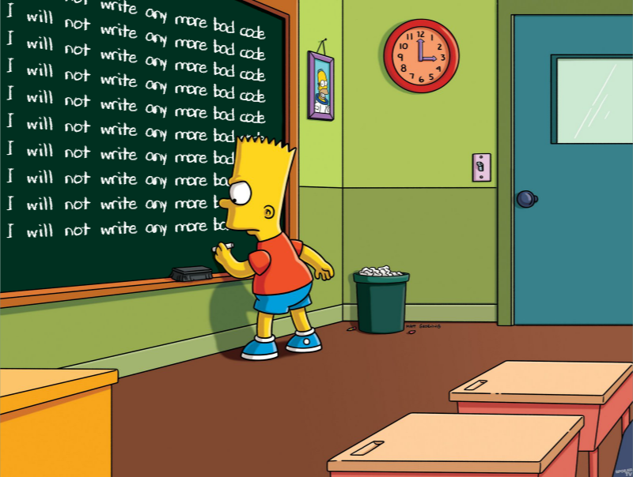
What did we learn
Voluntary is not without obligation
Time is your enemy
Initiating a hackathon creates speed
Don’t reject ugly code too fast
HTTPS://WWW.LITTIL.ORG
Notes:
Talk Eddy

Slide 33
JOIN US !! This is what you can expect
Contributor open-source project
Learn new people from the community
Gain knowledge from the community
Kids and schools will have benefit from your contribution
HTTPS://WWW.LITTIL.ORG
Notes:
Talk Eddy

Slide 34




Big thanks to our sponsors!
HTTPS://WWW.LITTIL.ORG
Notes:
Talk Eddy

Slide 35
Big thanks to our sponsors!
Big thanks to our contributors!
Anja
Barry
Bram
Candy
Dick
Eddy
Eelco
Evelien
Hans
Jack
Jasper
Jens
Jos
Kaya
Koen
Lennert
Maarten
Marcel
Marijn
Mark
Maurits
Michaël
Nirav
Ola
Oscar
Pepijn
Pim
Ramond
Roeland
Ron
Roy
Saskia
Stefan
Wesley
Wilko
Willem
DependaBot
HTTPS://WWW.LITTIL.ORG
Notes:
Talk Eddy

Slide 36
LITTIL contact information
Koen Aerts – President Devoxx4Kids – koen@devoxx4kids.nl
Saskia Vermeer Ooms – Secretary Devoxx4Kids – saskia@devoxx4kids.nl
Eddy Vos – Product Owner LITTIL – eddy@devoxx4kids.nl
Contact address for schools and IT engineers : info@littil.org
Website Devoxx4Kids : https://www.devoxx4kids.nl
Website LITTIL : https://www.littil.org (currently in Dutch)
GitHub LITTIL : https://github.com/Devoxx4Kids-NPO
(Slides & documentation included)
Notes:
Talk Eddy

